Slide 1


Fundamentals
Where do I find MATLAB? Here!
Do I have to have MATLAB installed on my computer right now? No, you can use MATLAB Online!

Slide 2

Table of Contents
What we've covered this week in Part 5 The MATLAB Live Editor Live Scripts Code Sections Providing Documentation MATLAB Code Files What we've covered this week in Part 6
MATLAB Live Script

Slide 3
What we've covered this week in Part 5
This week in Part 5 we learnt about:
Arithmetic operations
Introduction to operator precedence
Making use of built-in Mathematical Functions

Slide 4

The MATLAB Live Editor
Using the Live Editor Video
How to Use Live Editor Controls Video
Live script Examples You Can Run
After selecting commands in the Command History, right-clicking displays a context menu. When you choose Create Live Script from the context menu, the selected commands are copied into a new Live Script file in the MATLAB Live Editor.
The Live Editor is used to write, edit, run, and share MATLAB Live Scripts, which are sequences of MATLAB commands together with embedded output, formatted text, equations, and images. Live scripts have a .mlx extension.
You can open the Live Editor and begin a new file by selecting New > Live Script in the File section of the Home tab on the toolstrip. To open an existing Live Script in the Live Editor, simply double-click the file in the Current Folder browser.

Slide 5
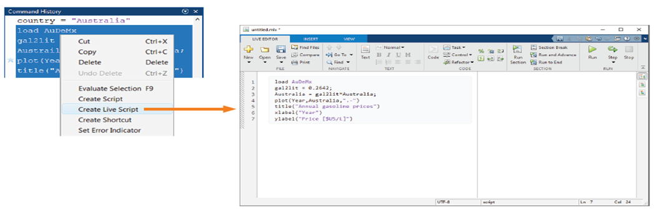
The MATLAB Live Editor
The Live Editor window has its own toolstrip, which contains controls for editing, navigating, running, and formatting your code.

Slide 6
Live Scripts
The sequence of commands you have just created in the Live Editor is a Live Script. When you run a Live Script, MATLAB executes the commands as a batch, in order. Any visible outputs from the commands are embedded directly in the Live Script.
Scripts are used to automate useful blocks of commands. Scripts do not have inputs and outputs. They operate on data in the workspace, and they can create new data on which to operate. Variables they create remain in the workspace and can be used in subsequent computations. Scripts can also produce graphical output by calling appropriate plotting functions.
Live Scripts display output with the line of code that creates it. By default, MATLAB displays the output to the right of the code. When you select an output, the cursor automatically moves to the line of code that generated it.
If a script is displayed in the Live Editor, you can run it by clicking the Run button in the Run section of the Live Editor tab on the toolstrip. Equivalently, you can press F5. Running a Live Script runs the code currently shown in the Live Editor, even if the file contains unsaved changes.

Slide 7
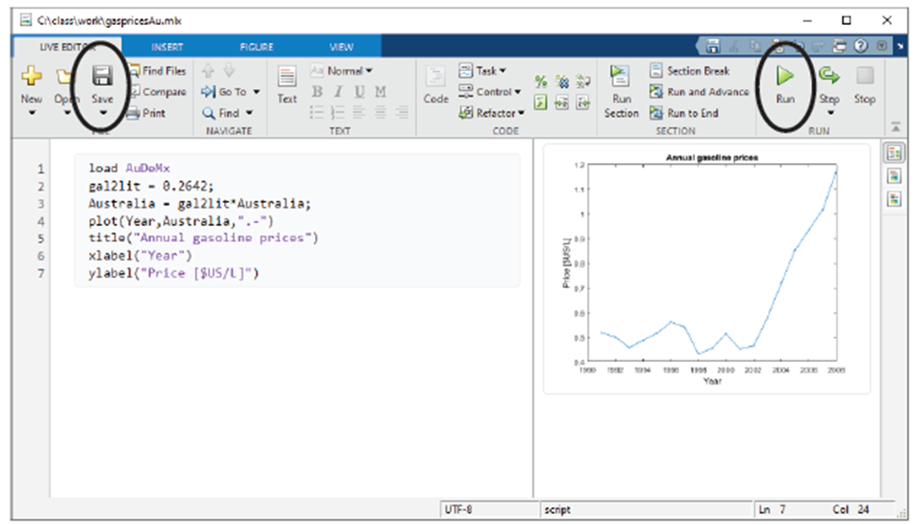
Live Scripts
When you save a Live Script, MATLAB automatically saves it with a .mlx extension. The file name in the Live Editor title bar is appended with an asterisk if the file has been modified.

Slide 8
Code Sections
The overall structure of most scripts naturally divides into sections. Especially for larger files, you may want to focus on one section at a time. To facilitate this, the Live Editor allows you to create code sections in your file.
A section consists of a section break and the lines that follow, up to the start of the next section, which is identified by another section break. You can create a section break by clicking the Section Break button in the Insert section of the Live Editor tab on the toolstrip, or by pressing Ctrl+Alt+Enter.
You can use the controls on the Live Editor tab of the toolstrip to navigate from section to section and evaluate the code in a section.

Slide 9
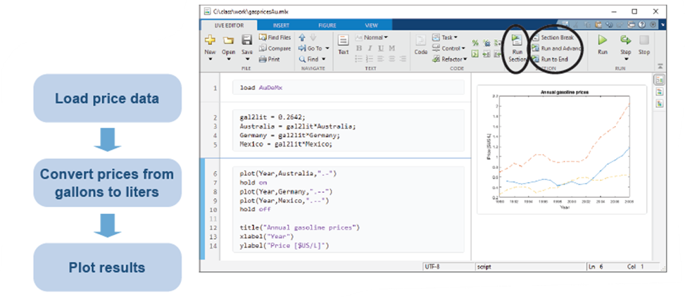
Code Sections
Sections allow you to modify and re-evaluate the code in that section to see how the changes affect the output. You do not need to commit to the change or rerun the entire file. This enables you to experiment rapidly with your code.

Slide 10
Providing Documentation
Code files should contain nonexecutable text and other supporting items that explain the code. The Live Editor lets you add formatted text, hyperlinks, images, and equations to enhance the readability of your MATLAB code and create a presentable, interactive document to share with others.
You can add nonexecutable text in a Live Script by clicking Text button in the Text section of the Live Editor tab. To return to entering code, you can click the Code button in the Code section of the Live Editor tab. You can press Alt+Enter to toggle between entering code and text.
Formatting text in a Live Script is like formatting text in a word processor. Use the controls in the Live Editor tab to make text bold, italic, underlined, or monospaced, or to add headings, titles, and bulleted or numbered lists.
The Insert tab also contains buttons to insert equations, images, and hyperlinks. When you insert one of these items, MATLAB places the item on a new text line directly below the selected line.

Slide 11
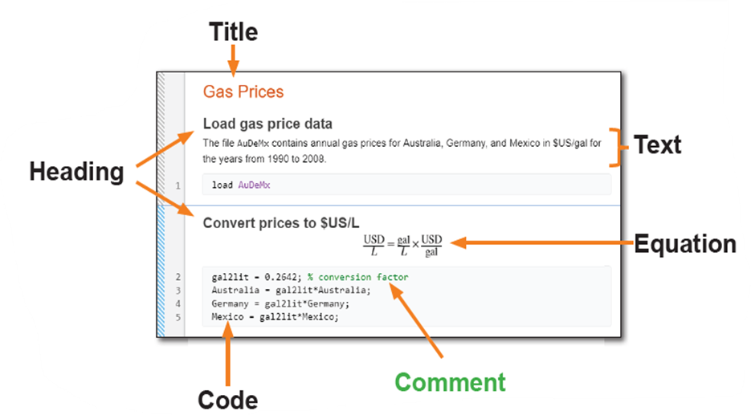
Providing Documentation
Equations can be inserted by using an interactive equation editor, or by entering a LaTeX equation. Only text lines can contain equations.
You may want to include text within block of code so you can keep related lines of code together in a single code block. Text following a percent sign (%) is a comment, or nonexecutable code. Comments can appear on lines by themselves, or they can be appended to the end of a line of code.

Slide 12
MATLAB Code Files
Sometimes it is advantageous to save your MATLAB scripts as plain text files. For example, when interfacing with external tools that are designed to work with text files, such as some source control software.
In these cases, MATLAB scripts can be saved as MATLAB code files which have the extension .m. Like Live Scripts, these code files allow users to run, edit, and share their code. Many of the features of live scripts, such as code sections, may be used in MATLAB code files, unlike Live Scripts however the output of the code is not saved inside the code file.

Slide 13
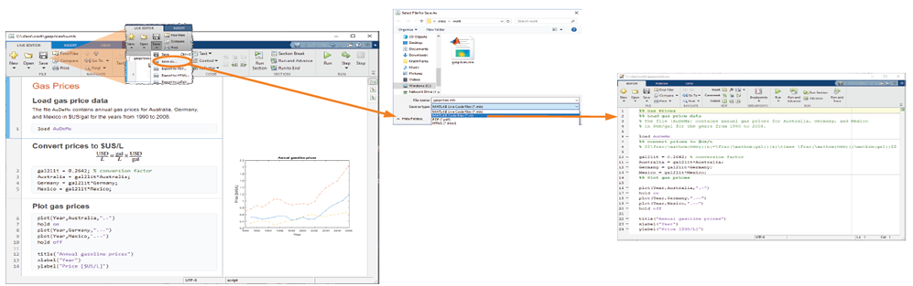
MATLAB Code Files
To convert a Live Script to a MATLAB code file by clicking Save > Save As... and selecting MATLAB Code File (*.m) from the Save as Type: menu.

Slide 14
What we've covered this week in Part 6
This week in Part 6 we learnt about:
Live Scripts
Code sections
Providing documentation
MATLAB code files

Slide 15
MATLAB Live Script
Click on the link below for this lecture’s MATLAB live Script
Week_1_Part_6_Fundamentals.mlx
Copyright 2022 The MathWorks, Inc. & Opti-Num Solutions (Pty) Ltd.

